Slide 1
Presentation overview
AGENDA
Introduction
How AI and ML are used
Problem to Solve
Dataset Explanation
Data Preparation
EDA
Algorithms Used
Algorithm comparison
Prediction
How does this help to Predict the Outbreak

Slide 2
Predict outbreak of the FLU

Slide 3
Introduction
A flu (influenza) pandemic is an outbreak caused by a new human flu virus that spreads around the world. Because the pandemic flu virus will be new to people, many people could get very sick or could die.
Predicting the outbreak helps public health officials make timely and meaningful decisions that could save lives.
In this model, we will predict the future number of cases for influenza based on the past two years data.

Slide 4
How AI and ML are used
Machine learning methods usually use data sequences retrieved over a period of time as inputs to predict outbreak of the flu.
The flu prediction using machine learning methods is more resourceful for both economically as well as logistically, than traditional methods.

Slide 5
Problem to Solve
Predicting number of Influenza-A cases in future years based on the data taken from the past years.
Analyzing the hike in the number of cases thereby predicting flu outbreak.

Slide 6
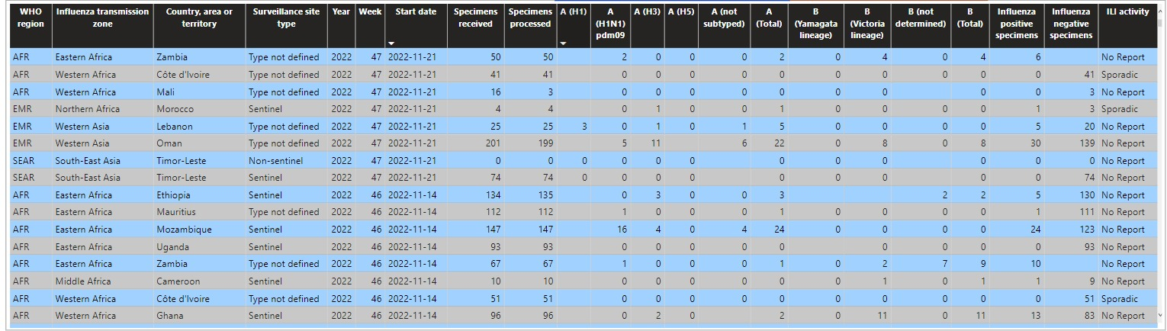
Dataset
Dataset TAKEN FROM WHO

Slide 7
Dataset Explanation
Country, Area or Territory – The place where the region belongs
Date – The first day of outbreak.
Week – First week of outbreak.
Influenza A cases – Number of Influenza A cases detected during outbreak.

Slide 8
Data Preparation
Data Preprocessing
Data Visualization
Feature Extraction
Model Evaluation

Slide 9
Data Preparation
Data Preprocessing – The null values are removed from the data set and the rows with same data are grouped to avoid multiple records for the same date.
Data Visualization - The data is visualized in different ways as below:
Histograms
Line Charts

Slide 10
Data Preparation
Feature Extraction – This step involves choosing the right features yield for better results. Features like Month, week and year are extracted from the date.
Model Evaluation – The data is trained using different models:
Linear Regression
SVM
FB Prophet

Slide 11
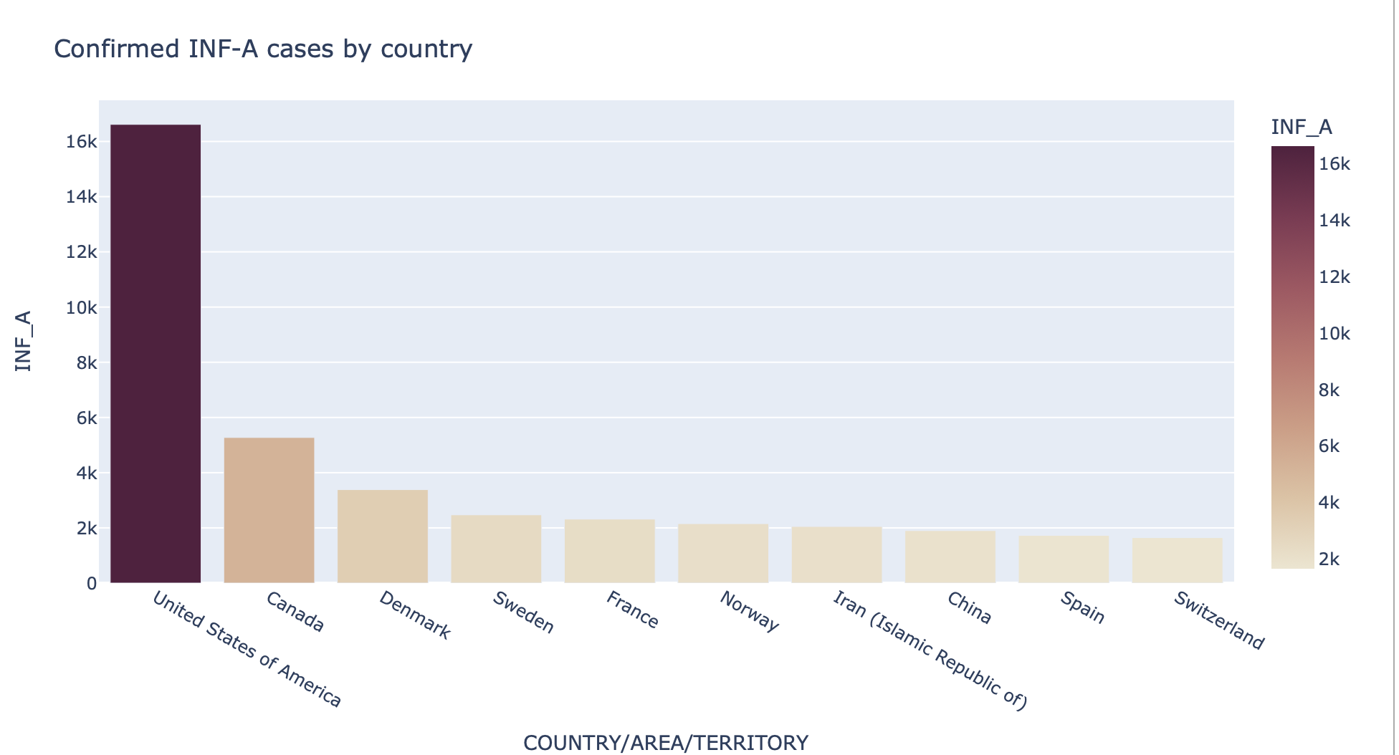
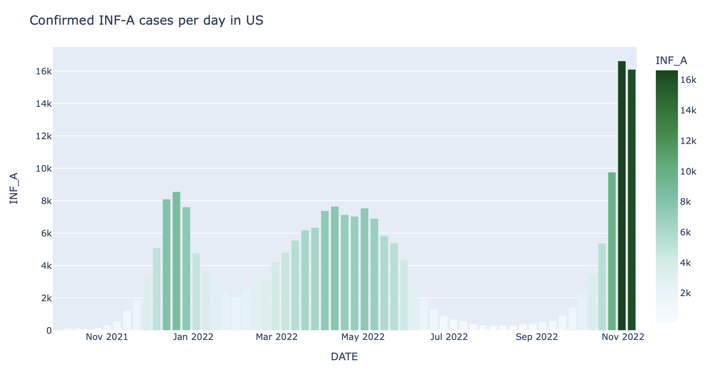
eda
Histogram - Confirmed INF_A cases by country, Histogram – Confirmed INF-A cases per day in US

Slide 12
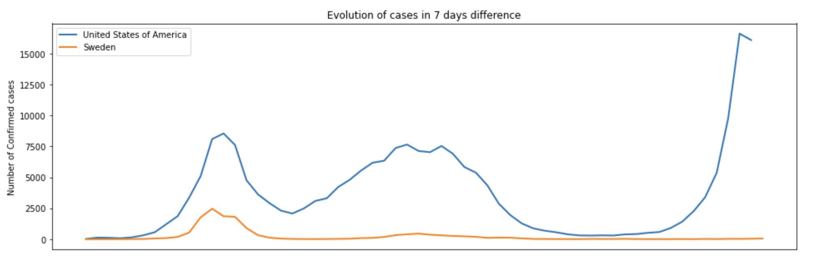
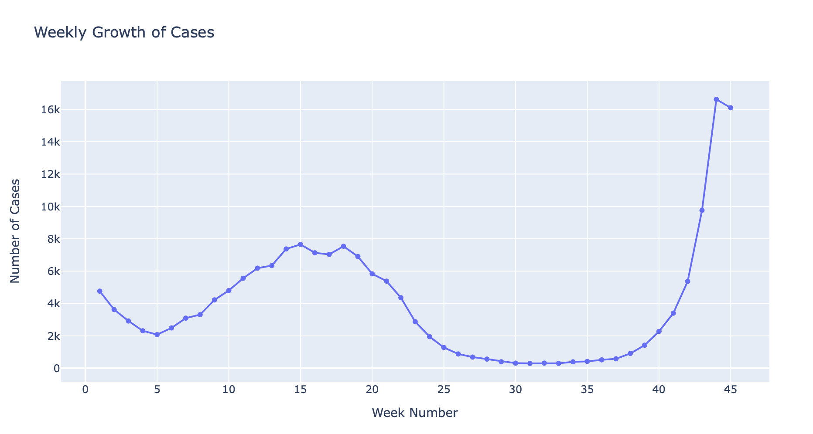
EDA
Line Chart – Evaluation of Cases in 7 days difference
Line Chart – Weekly Growth of Cases

Slide 13
Algorithms Used
Linear Regression
SVM
FB Prophet

Slide 14
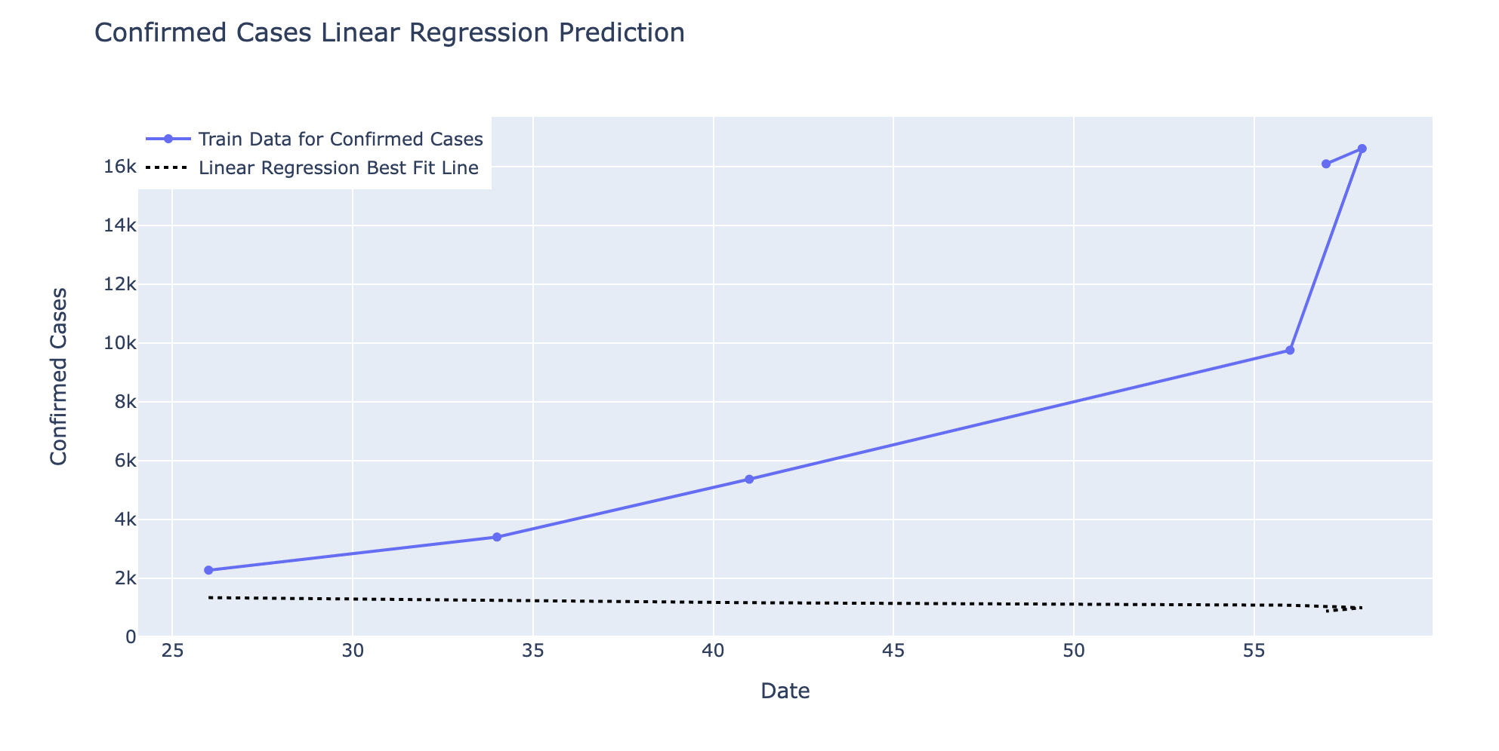
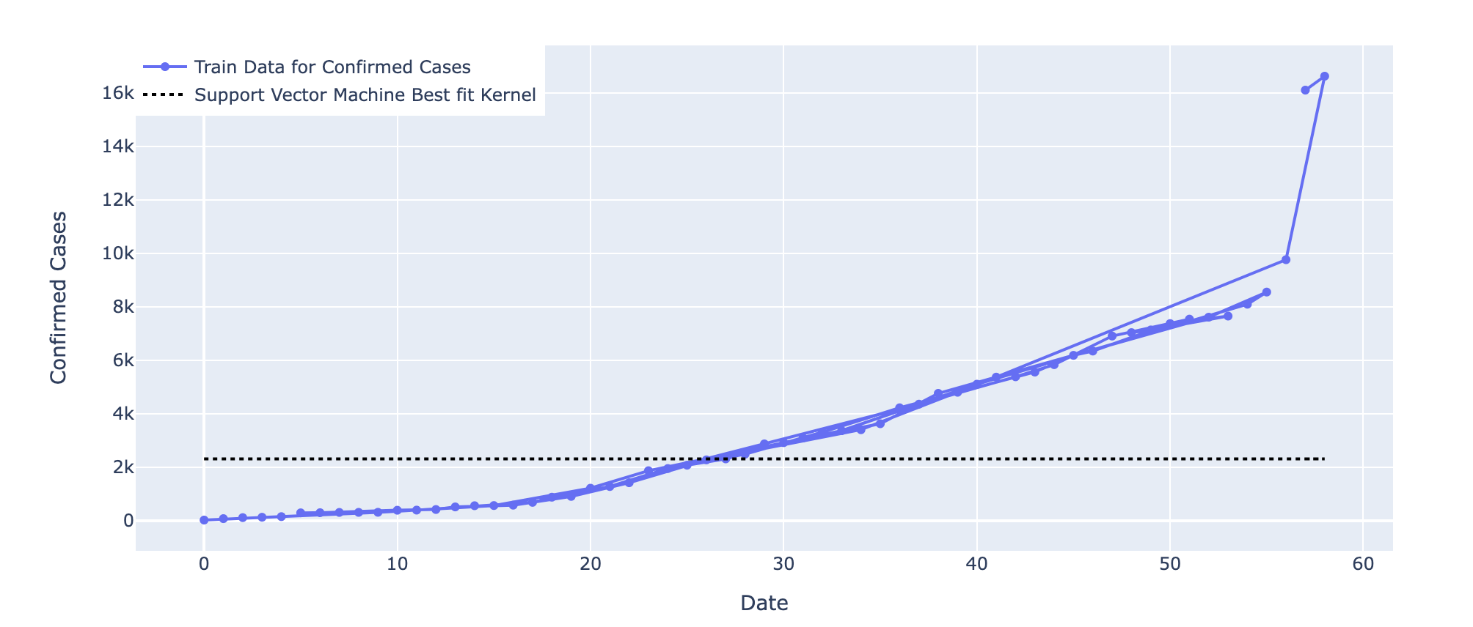
Algorithm comparison
The root-mean square error observed was least in SVM (support vector machines) compared to linear regression.
Comparatively both the algorithms didn't work as expected because training data was less.

Slide 15
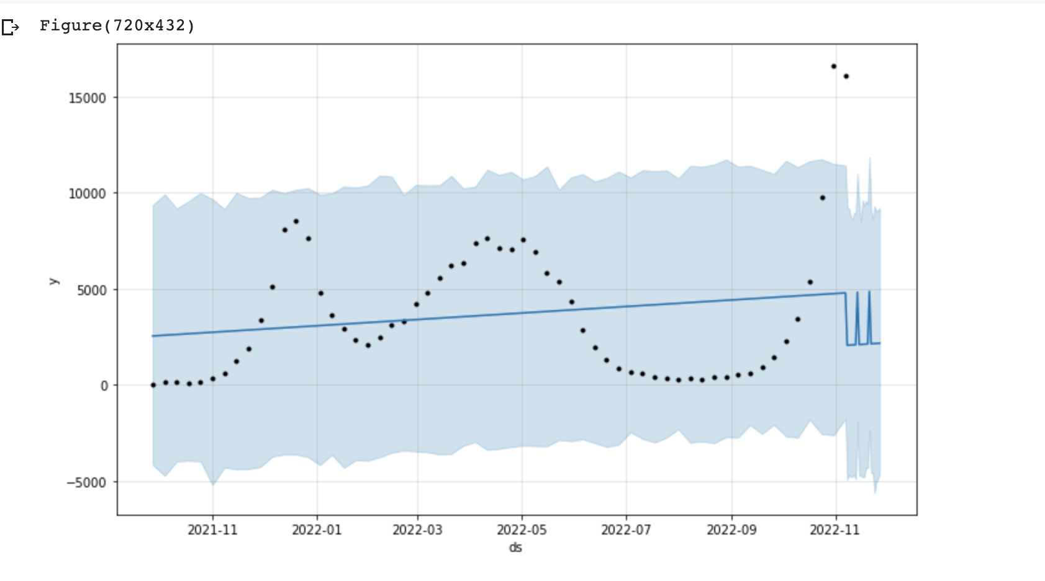
Performance using fb prophet
Additionally, we used FB prophet where the root-mean square error was lower when compared to other algorithms.

Slide 16
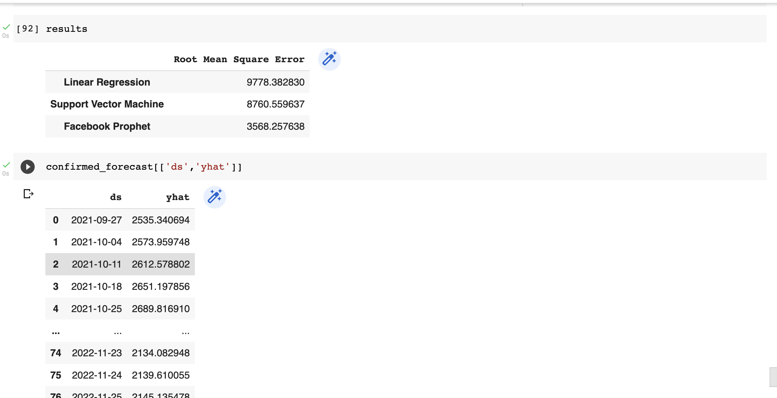
Prediction
These are the predicted number of cases for the future dates.

Slide 17
How does this help to Predict the Outbreak
By analyzing the hike in the number of cases we can predict if there is an outbreak in future.

Slide 18
references
https://www.kaggle.com/code/ryanholbrook/linear-regression-with-time-series
https://www.kaggle.com/code/cihan063/covid-19-future-prediction
https://www.kaggle.com/code/robikscube/time-series-forecasting-with-prophet

Slide 19
Thank you
ANY QUESTIONS ?

